Slide 1
Home In Tacoma Project
TPAG
November 15, 2023

Slide 2
Revised project schedule
July to Dec 2023
Jan to March 2024
April to June 2024
Develop full package
EIS Consultation
Planning Commission Public Hearing
Release Draft EIS
Planning Commission recommendation
City Council review
Release Final EIS
Council Public Hearing
Council action
INPUTS
Round 1 engagement
2023 legislative direction
Round 2 engagement
Ongoing engagement throughout

Slide 3
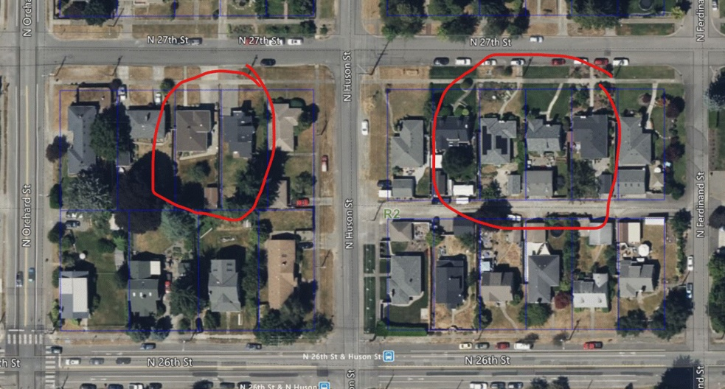
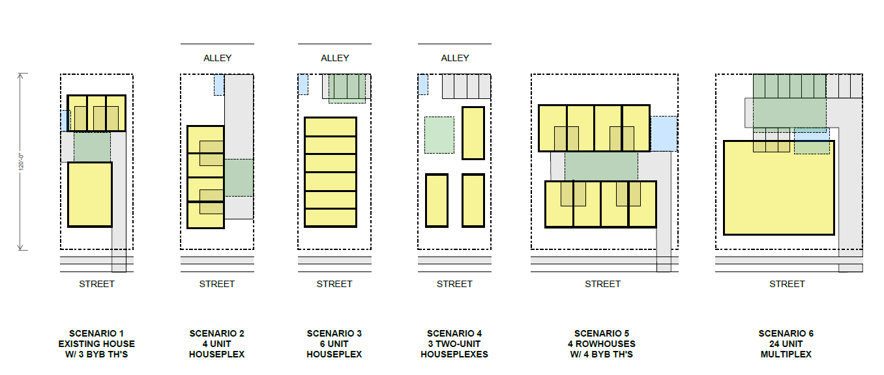
Site Planning exercise – thanks SubCommittee!
SCENARIOS – work in progress…

Slide 4
Site planning – study will include…
Zoning and standards (setbacks, FAR, trees, amenity space, etc)
Frontage improvements (curb, gutter, sidewalk)
Parking (cars, bikes), driveways, pedestrian access
Utilities (Solid waste, water, power, stormwater)
In discussions now with city review groups on standards updates

Slide 5
Objectives
Seeking guidance on
Building Design Standards (organized around proposed housing types, building placement, access and parking, building width and depth, building articulation)
Unit Lot Subdivisions (allowing separate ownership of attached and detached middle housing on a single parent lot)
Residential Target Area (adding areas the Multifamily Tax Exemption can be used)
Land Uses (accommodating middle housing and adjusting standards for Special Needs Housing, Non-residential uses in residential zones, and Short-term Rentals)
Building Code Changes (Visitability)
Bonus Program (affordability levels to target)
Middle Housing Market Feasibility
Round 3 Engagement
Notes:
Add title slides at beginning of each section
Building scale: slide on Res Patterns – reasonable compatibility, backyard height – lower? Does it make sense to have lower height to reflect ?
FAR – needs to go up to some extent – how far? Here’s a concept… spend some time showing what it means.
For balancing act:
Houseplex at 1.0 FAR – then vary by amount of amenity space+trees vs parking – then test against other housing types
For Parking High/low amenity space + trees, Parking low/high amenity space+trees (maybe bottom for amenity space is how much is needed for trees)
Two balancing acts – one houseplex, one multiplex… hold FAR/number of units constant, tradeoff between parking and landscaping/trees
The options better work, and there should be enough room for bonusing flexibility
All we really need is direction they are leaning… we can get their read about where they are willing to go.

Slide 6
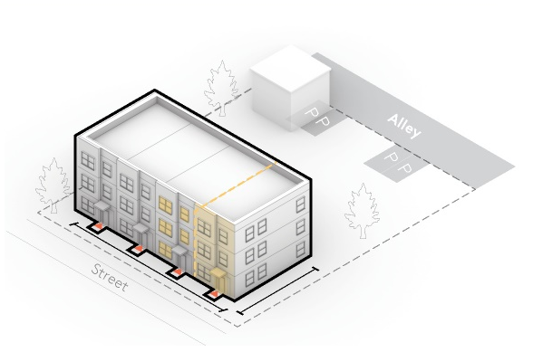
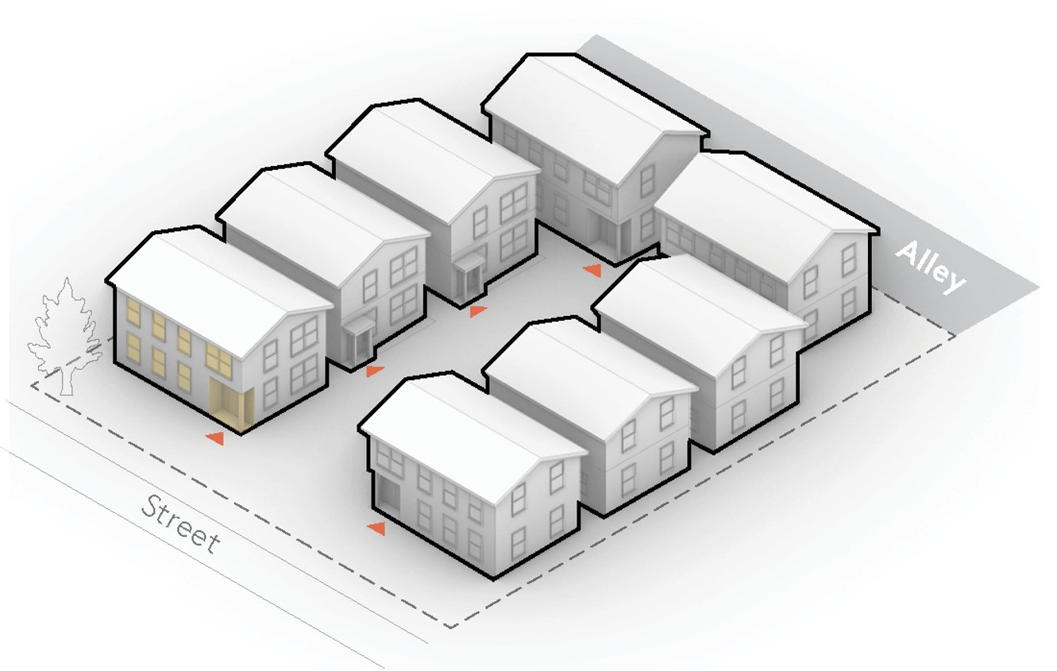
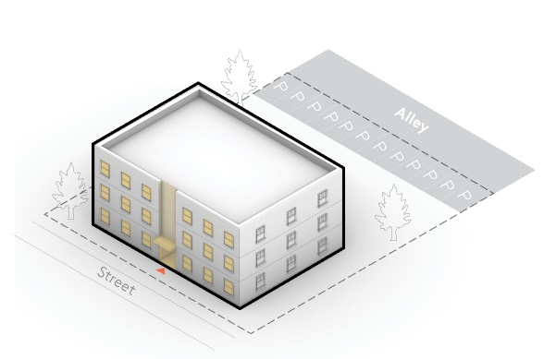
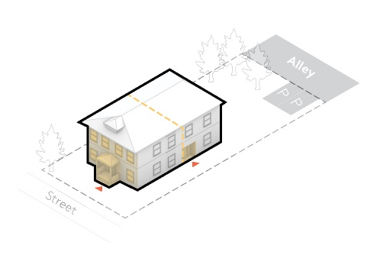
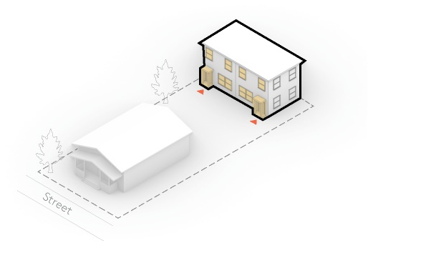
Housing Types
Houseplex*
Backyard Building
Rowhouse
Courtyard Housing
Multiplex
A single building with 1-6 units, which is generally the size of a single-family house and includes an entry from the street and a backyard.
A building located behind another structure at the rear of a lot. It is accessed from a shared or private path from the street. May contain 1-6 units.
A multi-story building with access to the street from its front door; it is always attached to 2 to 5 other Rowhouses, which together create a “Rowhouse Cluster”.
A group of detached or attached units arranged around a shared courtyard which is a shared social space which takes the place of private back yards.
A medium building consisting of 7 or more stacked units with the appearance of a large house or a small apartment building.
*AKA “House, Duplex, Triplex, 4-plex, 5-plex, 6-plex (Houseplex) including SF homes
Housing Types may be combined on a site
Notes:
Make sure to say SF homes are still allowed here

Slide 7
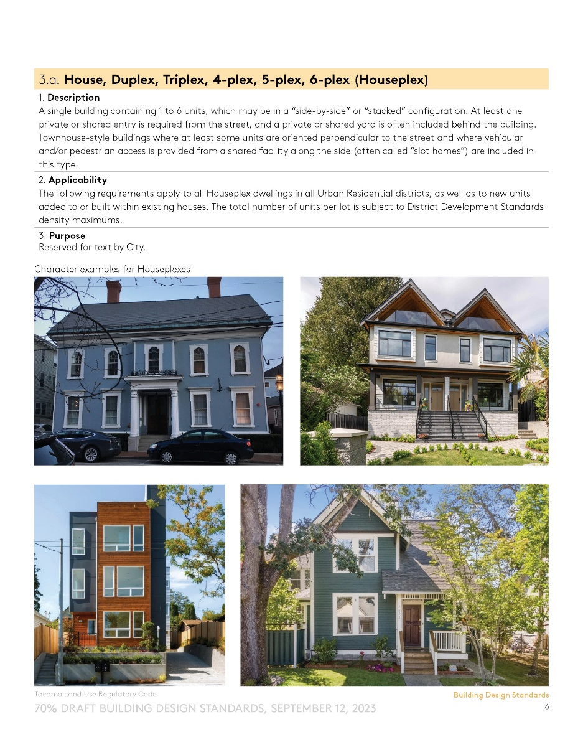
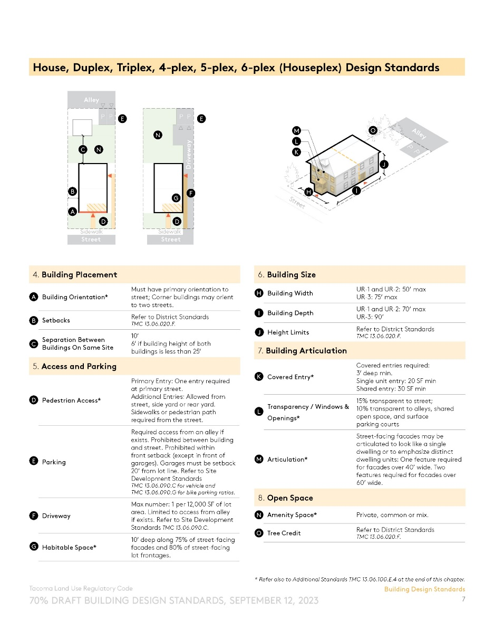
Building Design Standards
Part 1: Housing type overview
Part 3: Housing type plans & diagrams
Part 2: Housing type examples
Part 4: Housing type standards table

Slide 8

Building Design Standards
Describes building dimensions, with some differences per zone
Describes how buildings sit on their lots and orient to the street
Describes finer-grained look & feel of buildings
Describes orientation & dimensions for people and cars
Describes yard (outdoor amenity) requirements

Slide 9
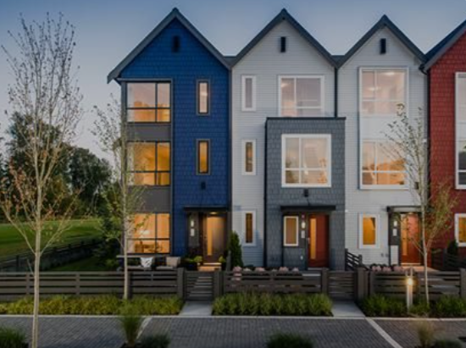
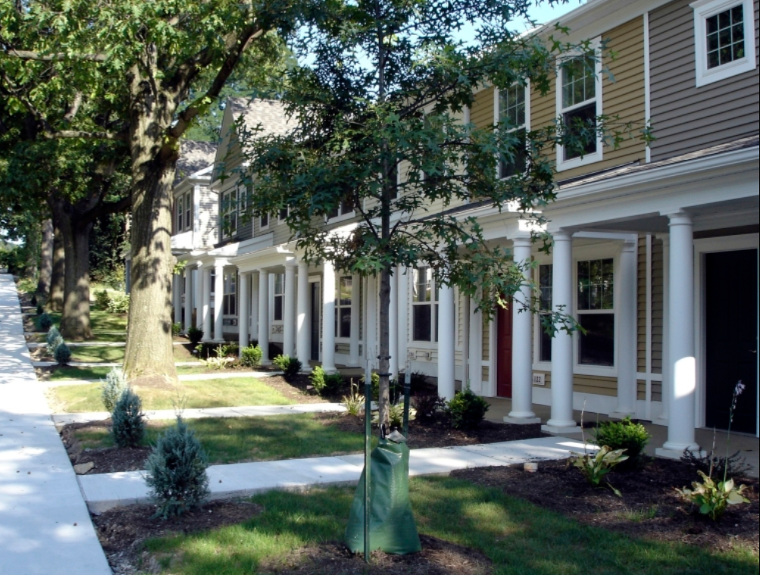
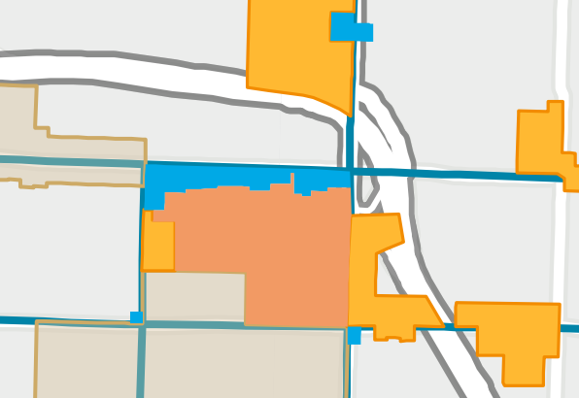
Actions to promote ownership, supply & affordability and accessibility
Unit Lot Subdivisions
Create fee-simple ownership opportunities through platting code that allows “unit lots”
Ensure functionality and compliance with standards
Visitability requirement
Adopt Building Code “Visitability” appendix
Require 1 Type C (Visitable) unit in 3+ unit buildings
Expand Multifamily Tax Exemption
Expand to all Mid-scale Residential areas with 12- and 20-year options (per HIT 1)
Include Multifamily High-density areas
6th Ave
Pearl St.
S. 12th St

Slide 10
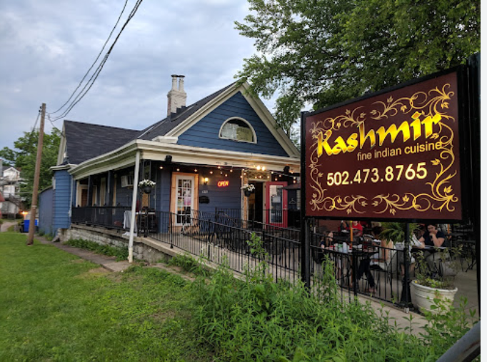
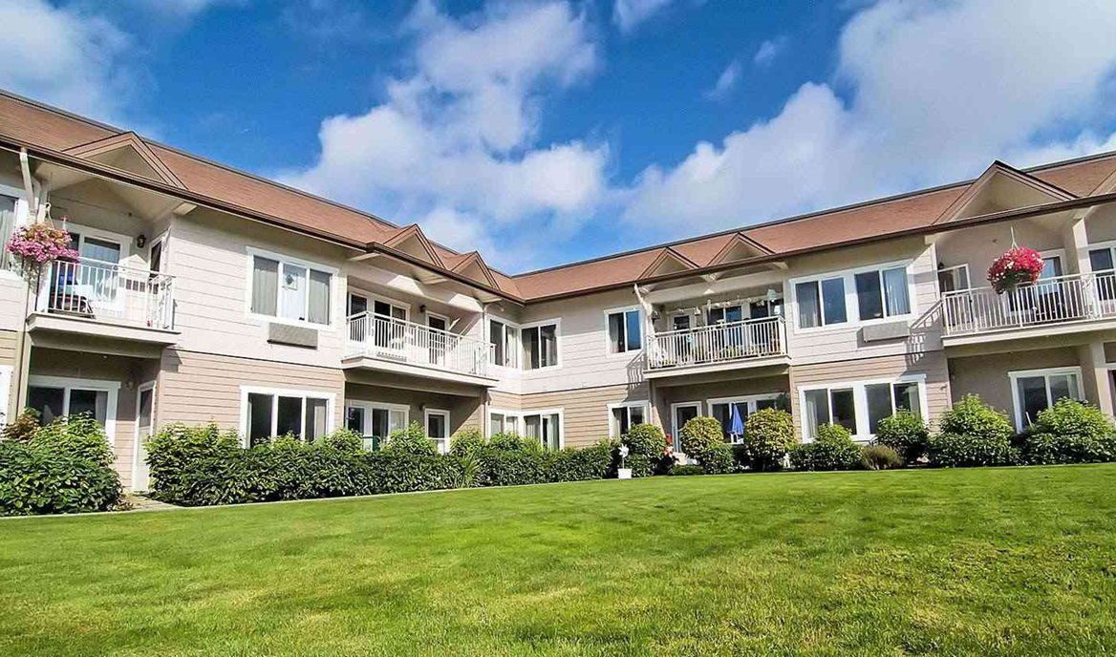
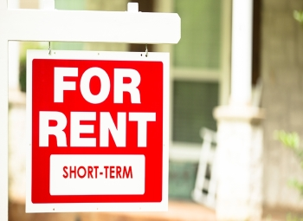
Land Use changes
Non-residential Uses
Increase options for small, neighborhood-serving businesses
Operational limits to reduce neighborhood impacts, more flexibility in UR-3
Support adaptive reuse of "Heritage Buildings“ in busier locations
Special Needs Housing
Reduce barriers to shared and supportive housing
Short Term Rentals
Further study needed of perceived issues (neighborhood impacts, affordable housing supply)

Slide 11
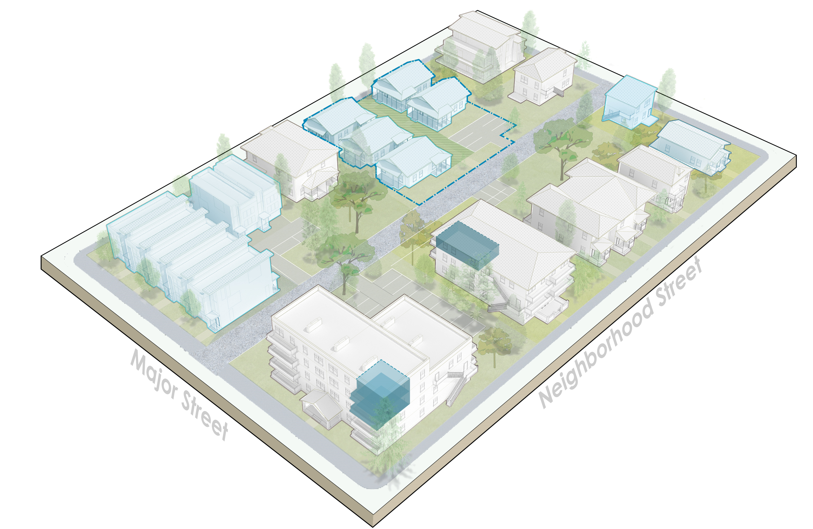
Affordability and Anti-displacement
Adopted policy direction
Keep cost in mind for MH standards
Strengthen regulatory affordable tools
Expand Multifamily Tax Exemption Program
AHAS & Anti-displacement strategy
Key Decisions
Understanding the market – promote affordability without slowing construction
Setting priorities – location, households served, duration of affordable units
What incentives and bonuses make sense
State law
Affordability bonus mandated (HB 1110)
Affordability levels, duration (RCW 36.70A.540)
Notes:
Legal interpretation question… HB 1110 – sets 2 units
Phase 1 direction
How we write housing rules matters for how much housing gets built and affordability
Middle housing is important – but there will remain unmet need for affordable housing
Ownership opportunities
Decisions:
Over next couple of months – gathering input on tradeoffs (both for standards AND for specific affordability tools); using that to come up with big moves
One basic concept – incentives need to be valuable to developers (often that means allowing bigger buildings/more units)
By March-April:
At neighborhood meetings, share how those could play out
Refinements to the proposals

Slide 12
Bonuses program - Observations
Middle Housing is financially feasible & will increase affordability and choice—but other actions needed for moderate to low-income households
Other City programs exist to create deeper affordability (could be expanded)
Bonus Program can help meet that need (and support other goals)
  Must make financial sense for developers (or nonprofits)
  Administrative burdens should be low (for City and developers)
Bonuses offered (can be combined) | Public benefits
More units (density) Larger buildings (FAR) Taller buildings (rear yard, UR-3) Parking reductions Multifamily Tax Exemption (in UR-3) | Affordability Retention of existing buildings
Notes:
There is a limit to value that can be “captured” for public benefits

Slide 13
Public benefit – Affordability targeting
Mostly, state law sets the parameters
Based on local housing need, targets 80% to 100% AMI
UR- 3 OPTION 1: 70% AMI rental, 100% AMI ownership
UR- 3 OPTION 2: 5% rental units 50% AMI + 15% at 70% AMI, 100% AMI ownership
Voluntary in all UR Zones
50-year length of affordability
Fee in lieu adjusted to reflect difference in value
Program review on regular basis
2 units (or 20%) in UR-1 & 2, 20% total units in UR-3
Can be layered with MFTE in UR-3

Slide 14
Baseline Feasibility Analysis

Slide 15
Key Findings
Increase in density → greater feasibility than single family
Likely to see diversity of housing (including unit size / bedroom count)
Ownership is typically more feasible than rental
Townhouse-type developments are the most feasible followed multiplex
Some rental types are less feasible due mostly to market dynamics
The type and the amount of housing built will vary greatly by market area
  More housing diversity in “medium” and “high” market areas
  Less development activity in “low” market areas.

Slide 16
Unit type and high market price
Below assumptions are a representation of what was considered reasonable for the higher market areas
 | Average Net Unit Size (sf)* | Average Rent | Average Sales Price | Percent of AMI
Single family | 2,300 | N/A** | $925,000 | 190%
Duplex (side by side) | 1,900 | N/A | $825,000 | 158%
3 Townhouses w/garages | 1,400 | N/A | $615,000 | 121%
4 Townhouses w/garages | 1,113 | N/A | $490,000 | 113%
6 Townhouses w/ no parking | 1,000 | N/A | $330,000 | 84%
Fourplex | 1,099 | $1,980 | N/A | 81%
Sixplex | 898 | $1,620 | N/A | 66%
Courtyard Housing, detached | 1,050 | $2,230 | N/A | 91%
Courtyard Housing, attached | 1,361 | $2,890 | N/A | 99%
Small Multiplex | 904 | $2,060 | N/A | 84%
Medium Multiplex | 680 | $1,500 | N/A | 78%
*Net of garage space if applicable.
**Though zoning does not regulate by tenure, the market tends to relate certain forms with rental or ownership. We therefore selected either a rental or ownership assumption for each form.

Slide 17
Results – High Market Area
Legend
Ownership
Rental
Key findings:
Greater feasibility than single family
Ownership is typically more feasible than rental
Townhouse-type developments are the most feasible followed multiplex
Some rental types are less feasible due mostly to market dynamics

